Slide 1
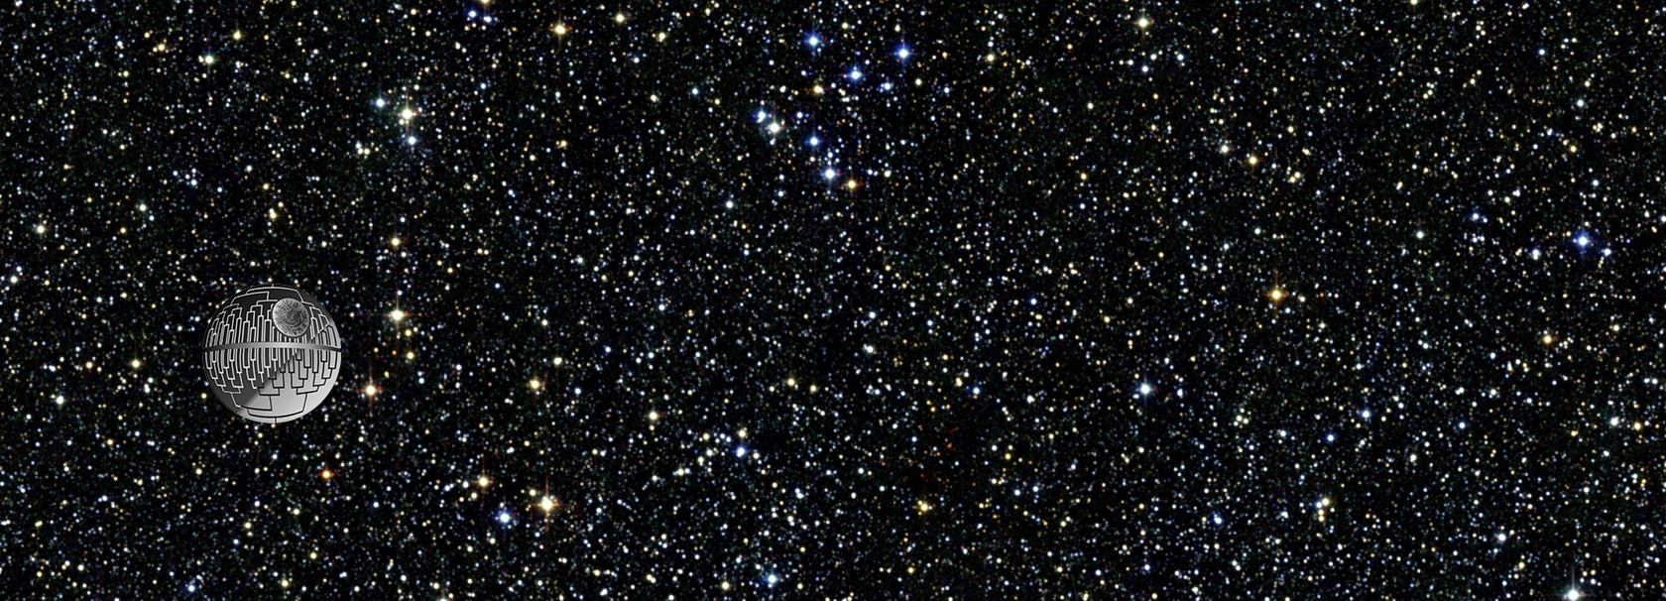

Phylogenetics Seminar
BIOL 4750/6750

Slide 2
Orientation, Introductions, Why phylogenetics?
Phylo Seminar Session 1
Jan 10 2024

Slide 3
Quick logistics
Nitty gritty
Lectures: Weds 10:30 to 11:45, in LSB 219.
Class Slack: USUTreeThinking.slack.com
For people who haven’t used it before, Slack is a messenger/socialmedia/texting-like application. We have a dedicated workspace for our class, which will be one of our main areas for interaction (among students, and between students and instructors). There’s a channel there limited to students (no instructors!), channels for asking questions, channels for showing off cool organisms, etc. My plan is for this workspace to stay in place for future years, and to function as a general hub for phylogenetics-related content and questions at USU.
Class Website: https://crothfels.github.io/PhyloSeminar/years/2024/2024/
This is where most of the action will be at. In addition to learning a lot about phylogenetics, you’ll get the pleasure of using git to upload your annotated bibliographies, etc.
Leading a session
Each student will be expected to lead a class session, which involves developing an annotated bibliography, assigning readings for the rest of the class, and delivering a short presentation to get the discussion going.
Grading
This is a participation-based seminar. All students who actively participate in class (ask questions, try to answer questions), in Slack (same), keep up with the readings, and who lead a session, will earn an A.

Slide 4
Introductions!

Slide 5
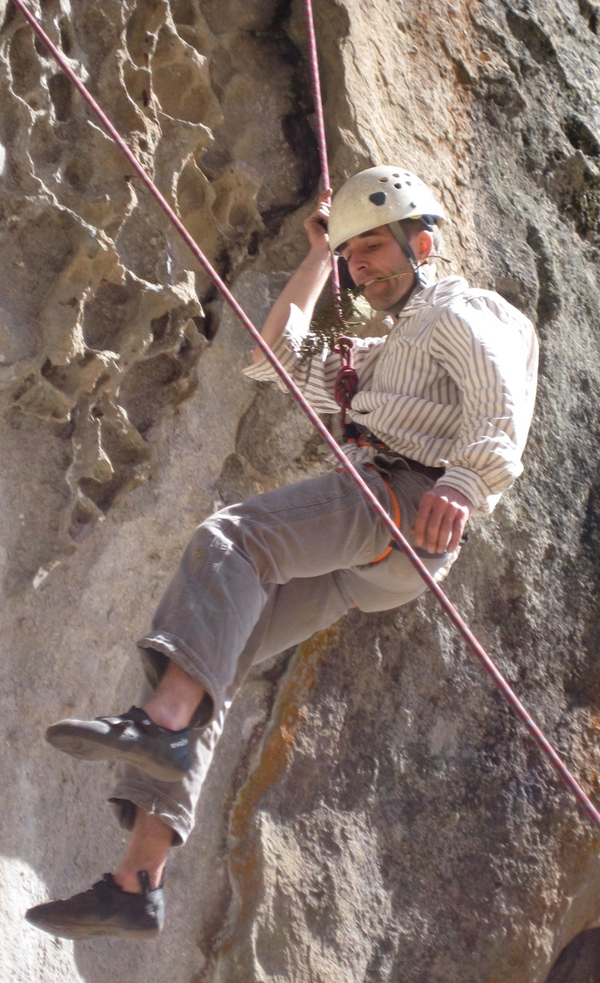

Introductions!
Me
Biology/Ecology Center associate professor, Intermountain Herbarium director
Systematist/evolutionary biologist, particularly interested in:
ferns and lycophytes
polyploidy
hybridization

Slide 6
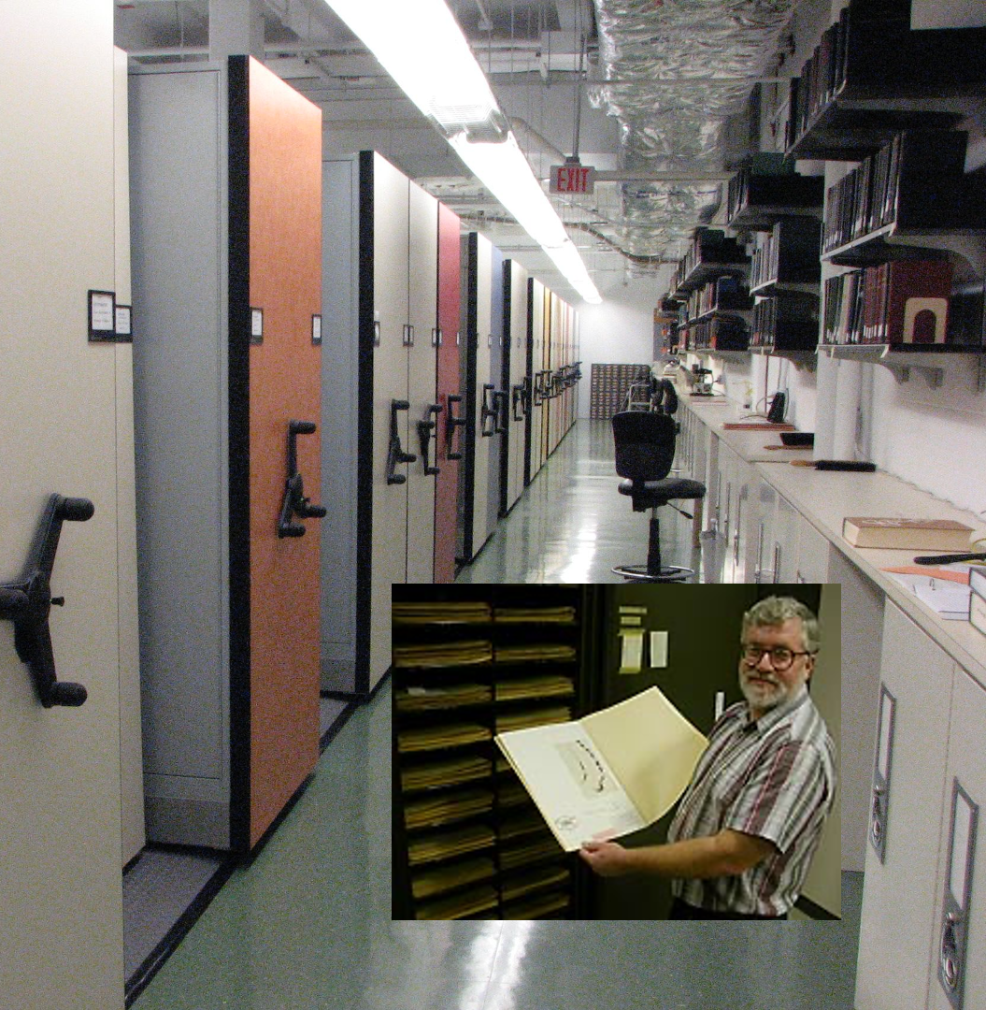

Introductions!
Me

Slide 7
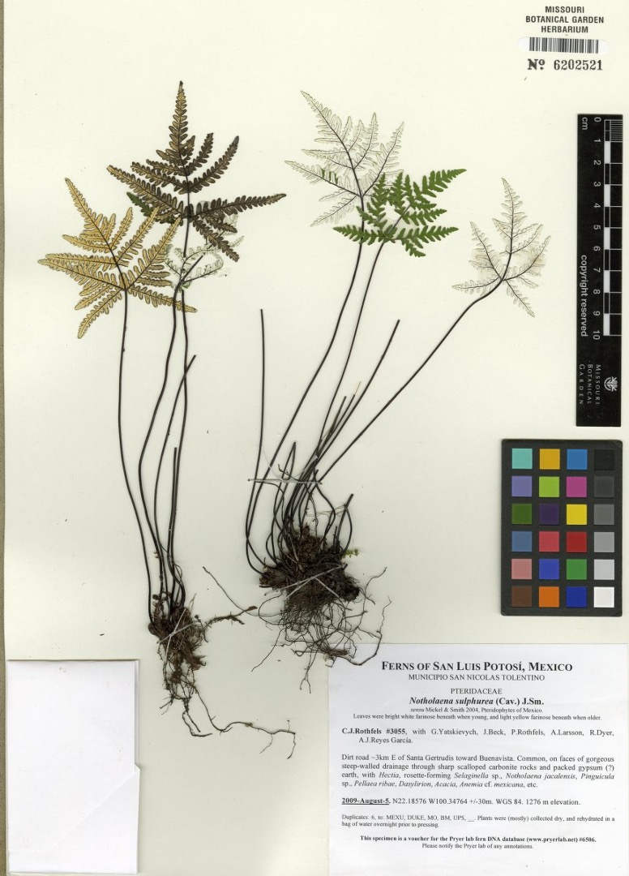
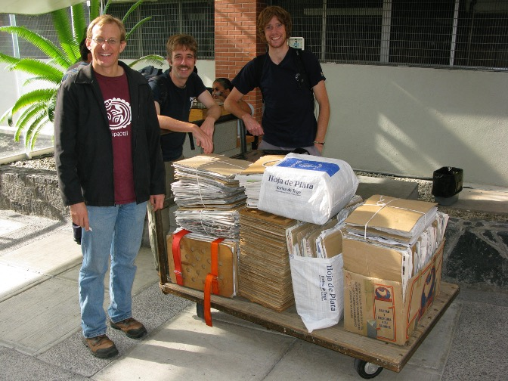

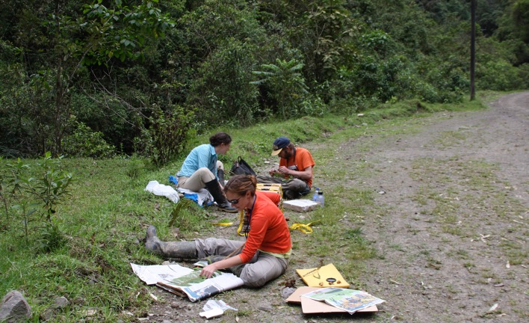
Introductions!
Me

Slide 8
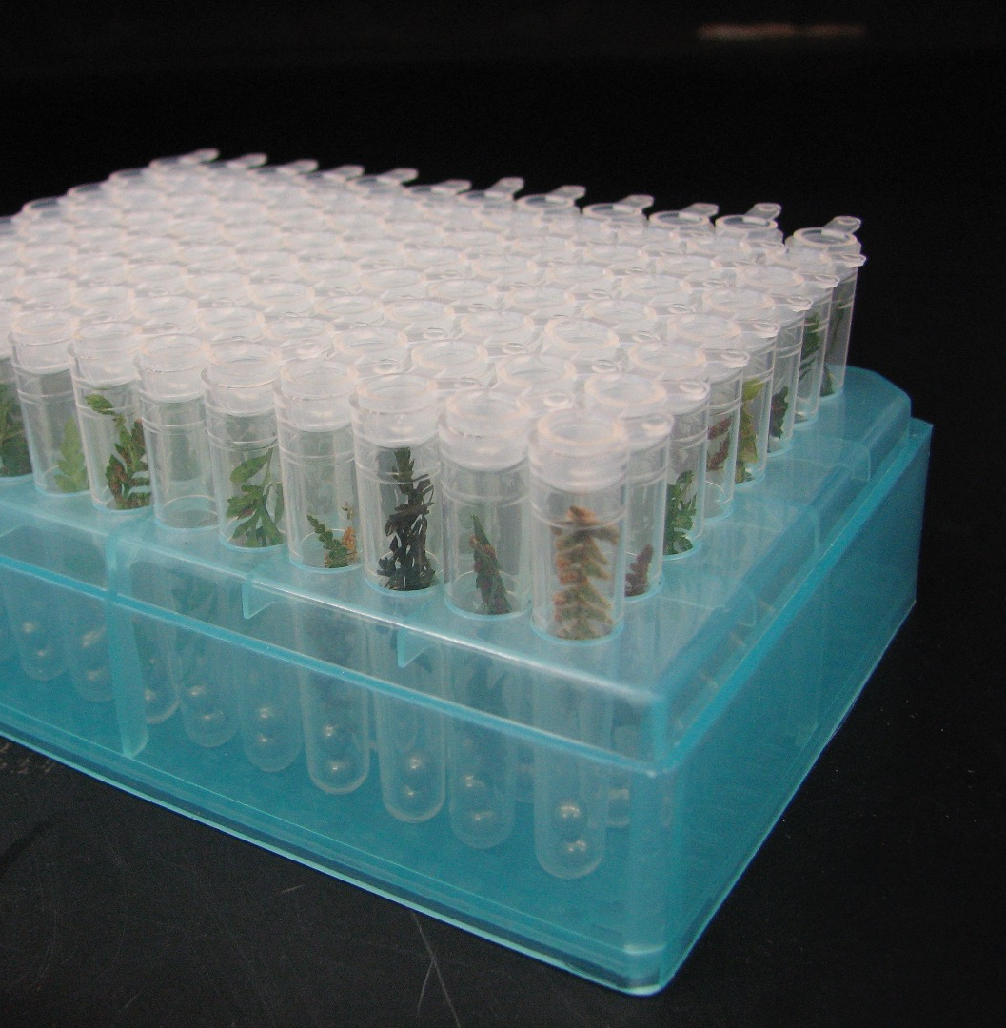
Introductions!
Me

Slide 9
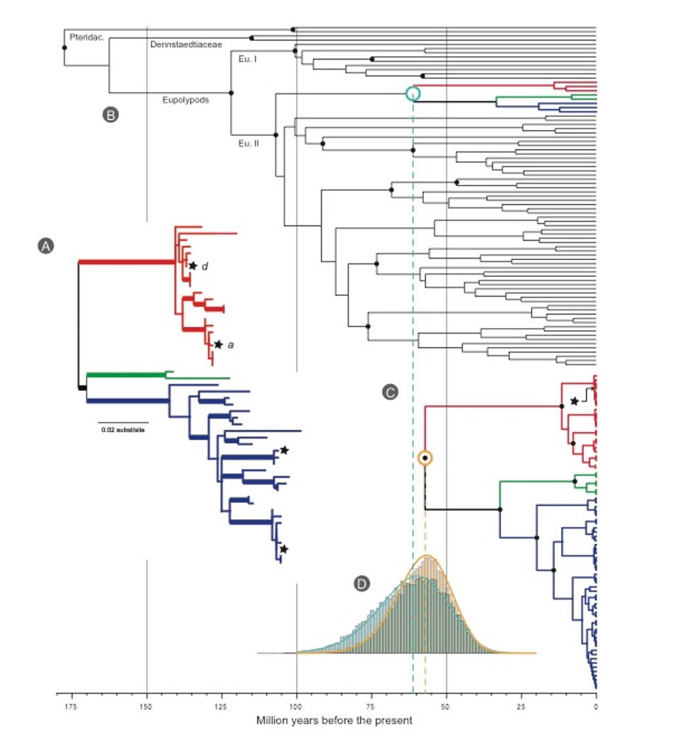
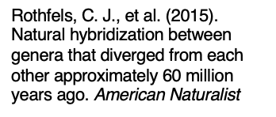
Introductions!
Me

Slide 10
Introductions!
me (still)

Slide 11
Introductions!
you!

Slide 12
Why phylogenetics?

Slide 13
Why phylogenetics?
‘cause
“Nothing in biology makes sense except in the light of evolution” (Theodosius Dobzhansky)
“Nothing in evolution makes sense except in the light of phylogeny” (maybe me?)

Slide 14
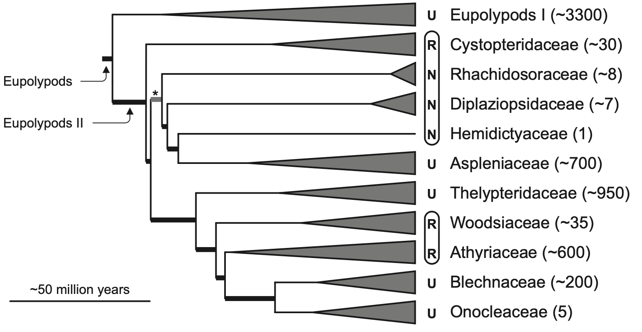
Why phylogenetics?
To know what’s related to what
Phylogenetics was initially developed by taxonomists, who were interested in describing biodiversity, and want to know what the evolutionary groups are
But there are many other reasons why it is useful to know what is related to what. E.g., so that we can bust a doctor who injected his former girlfriend with HIV from one of his patients
Rothfels et al. 2012 Taxon

Slide 15
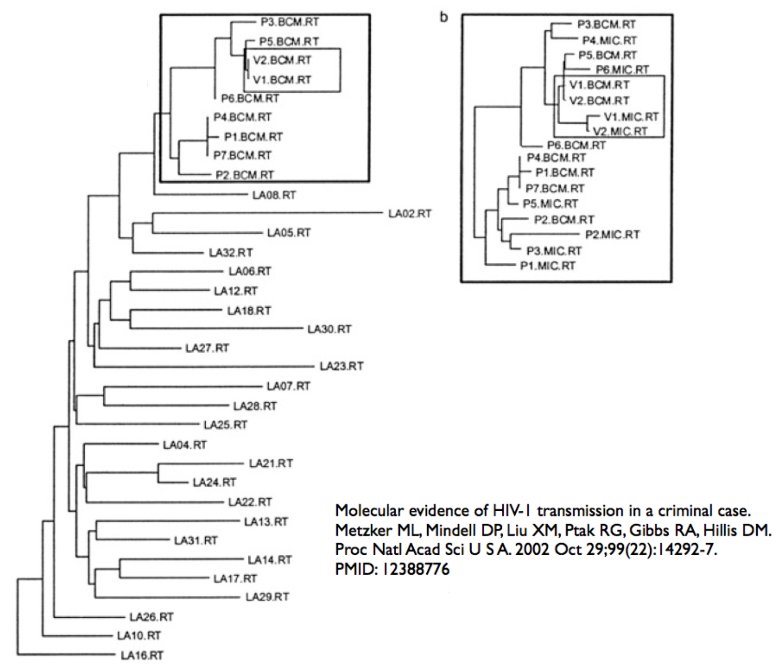
Why phylogenetics?
To know what’s related to what
Phylogenetics was initially developed by taxonomists, who were interested in describing biodiversity, and want to know what the evolutionary groups are
But there are many other reasons why it is useful to know what is related to what. E.g., so that we can bust a doctor who injected his former girlfriend with HIV from one of his patients

Slide 16
Why phylogenetics?
And so much more… you can:

Slide 17
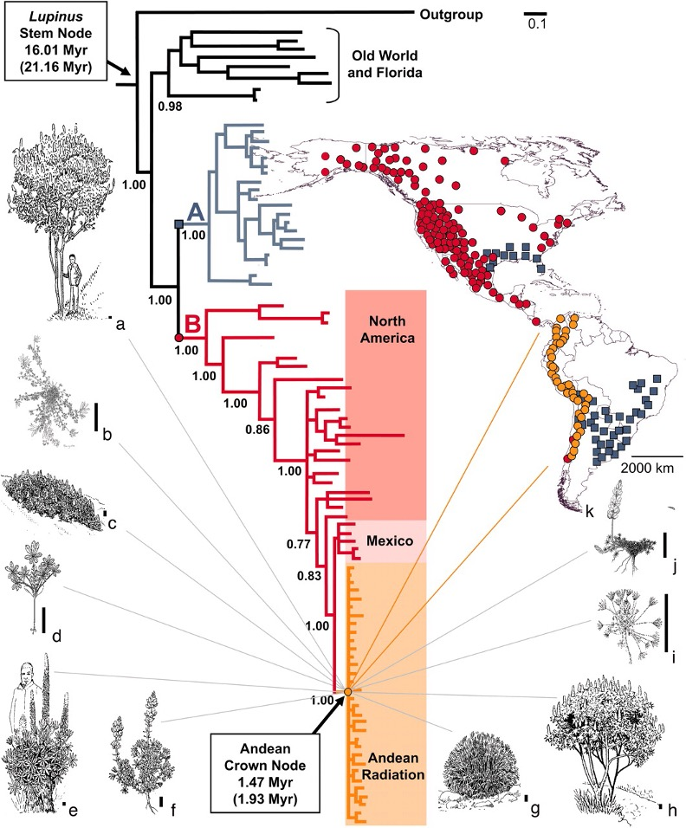
Why phylogenetics?
And so much more… you can:
Infer how lineages moved through space (biogeography)
Infer how characters changed over time (morphological and molecular evolution)
Infer how lineages have diversified (infer speciation and extinction rates, and see if they are correlated with particular features of the organism)
Quantify the distribution of evolutionary diversity over space (phylodiversity)
Infer the timing of major evolutionary events
Infer the history of novel pathogens (e.g., the origin and spread of SARS-CoV-2)
Detect signatures of natural selection on individual genes (identify particular amino acids that are under selection in SARS-CoV-2)
Infer the history of populations: their ancestral population sizes, patterns of migration, etc.
Hughes and Eastwood 2006 PNAS

Slide 18
Why phylogenetics?
And so much more… you can:
Infer how lineages moved through space (biogeography)
Infer how characters changed over time (morphological and molecular evolution)
Infer how lineages have diversified (infer speciation and extinction rates, and see if they are correlated with particular features of the organism)
Quantify the distribution of evolutionary diversity over space (phylodiversity)
Infer the timing of major evolutionary events
Infer the history of novel pathogens (e.g., the origin and spread of SARS-CoV-2)
Detect signatures of natural selection on individual genes (identify particular amino acids that are under selection in SARS-CoV-2)
Infer the history of populations: their ancestral population sizes, patterns of migration, etc.
Hughes and Eastwood 2006 PNAS

Slide 19
Why phylogenetics?
And so much more… you can:
Infer how lineages moved through space (biogeography)
Infer how characters changed over time (morphological and molecular evolution)
Infer how lineages have diversified (infer speciation and extinction rates, and see if they are correlated with particular features of the organism)
Quantify the distribution of evolutionary diversity over space (phylodiversity)
Infer the timing of major evolutionary events
Infer the history of novel pathogens (e.g., the origin and spread of SARS-CoV-2)
Detect signatures of natural selection on individual genes (identify particular amino acids that are under selection in SARS-CoV-2)
Infer the history of populations: their ancestral population sizes, patterns of migration, etc.
Hughes and Eastwood 2006 PNAS

Slide 20
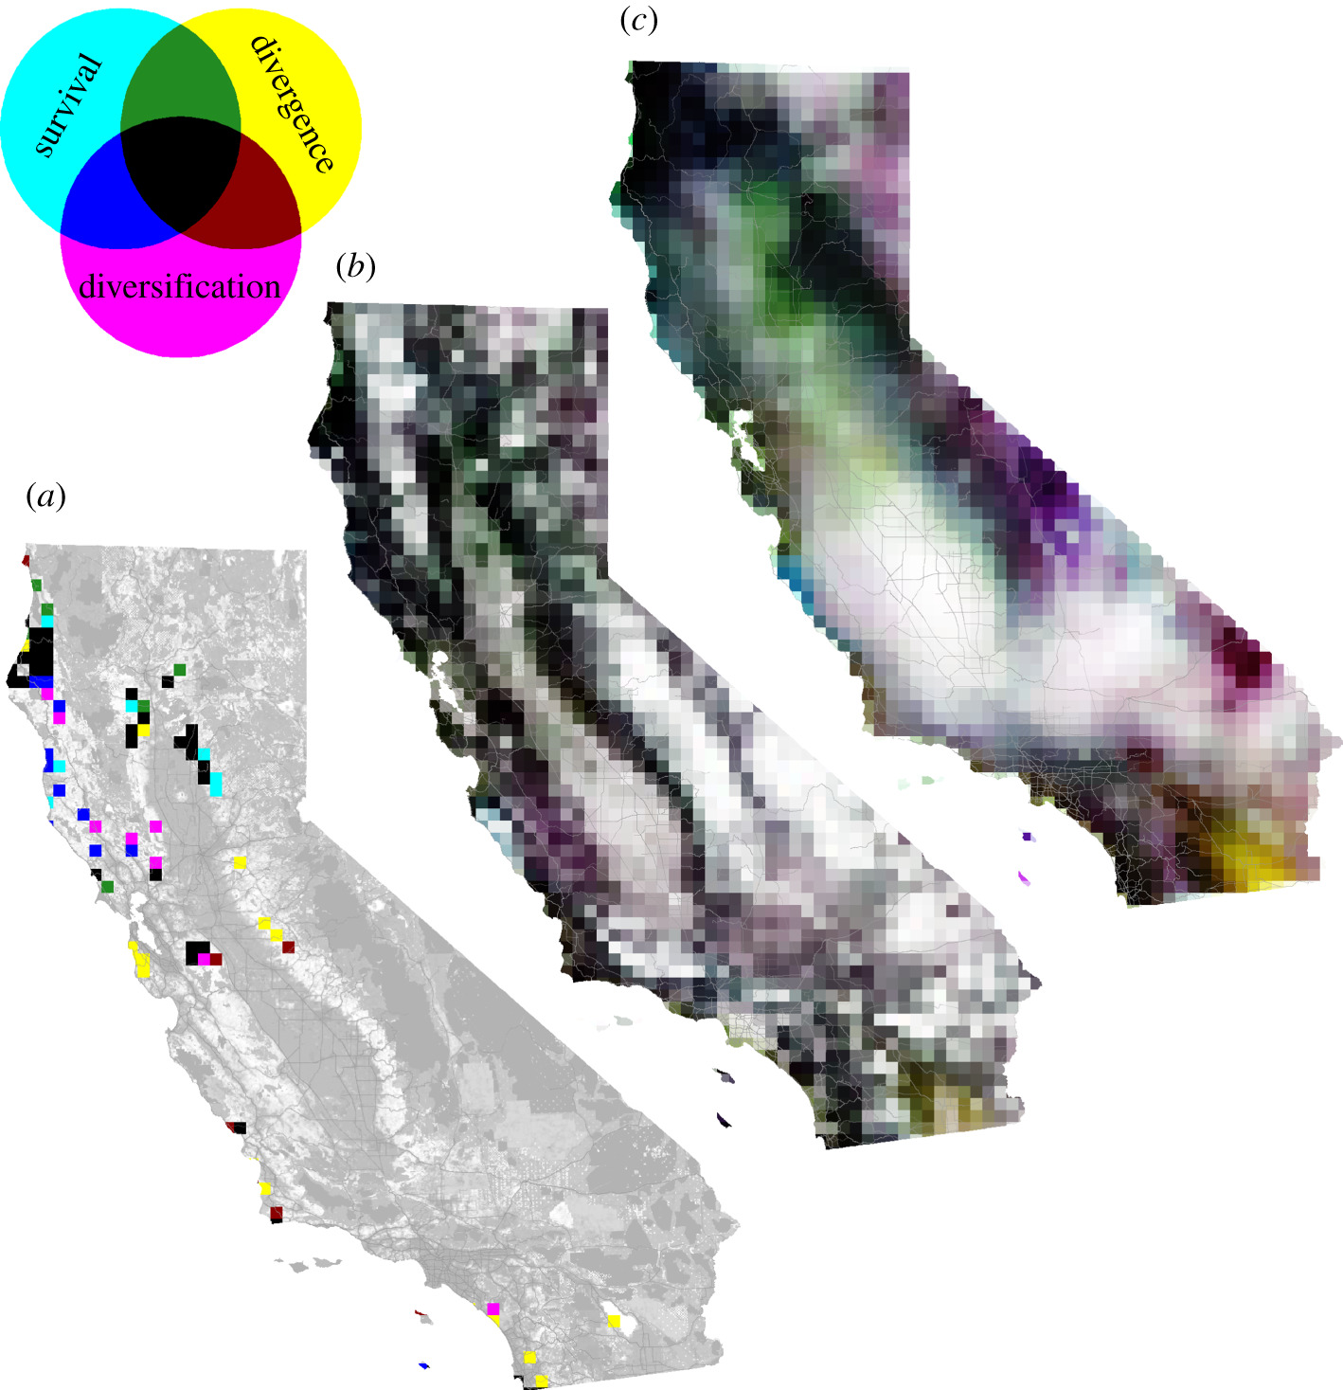
Why phylogenetics?
And so much more… you can:
Infer how lineages moved through space (biogeography)
Infer how characters changed over time (morphological and molecular evolution)
Infer how lineages have diversified (infer speciation and extinction rates, and see if they are correlated with particular features of the organism)
Quantify the distribution of evolutionary diversity over space (phylodiversity)
Infer the timing of major evolutionary events
Infer the history of novel pathogens (e.g., the origin and spread of SARS-CoV-2)
Detect signatures of natural selection on individual genes (identify particular amino acids that are under selection in SARS-CoV-2)
Infer the history of populations: their ancestral population sizes, patterns of migration, etc.
Kling et al. 2018 Proc B

Slide 21
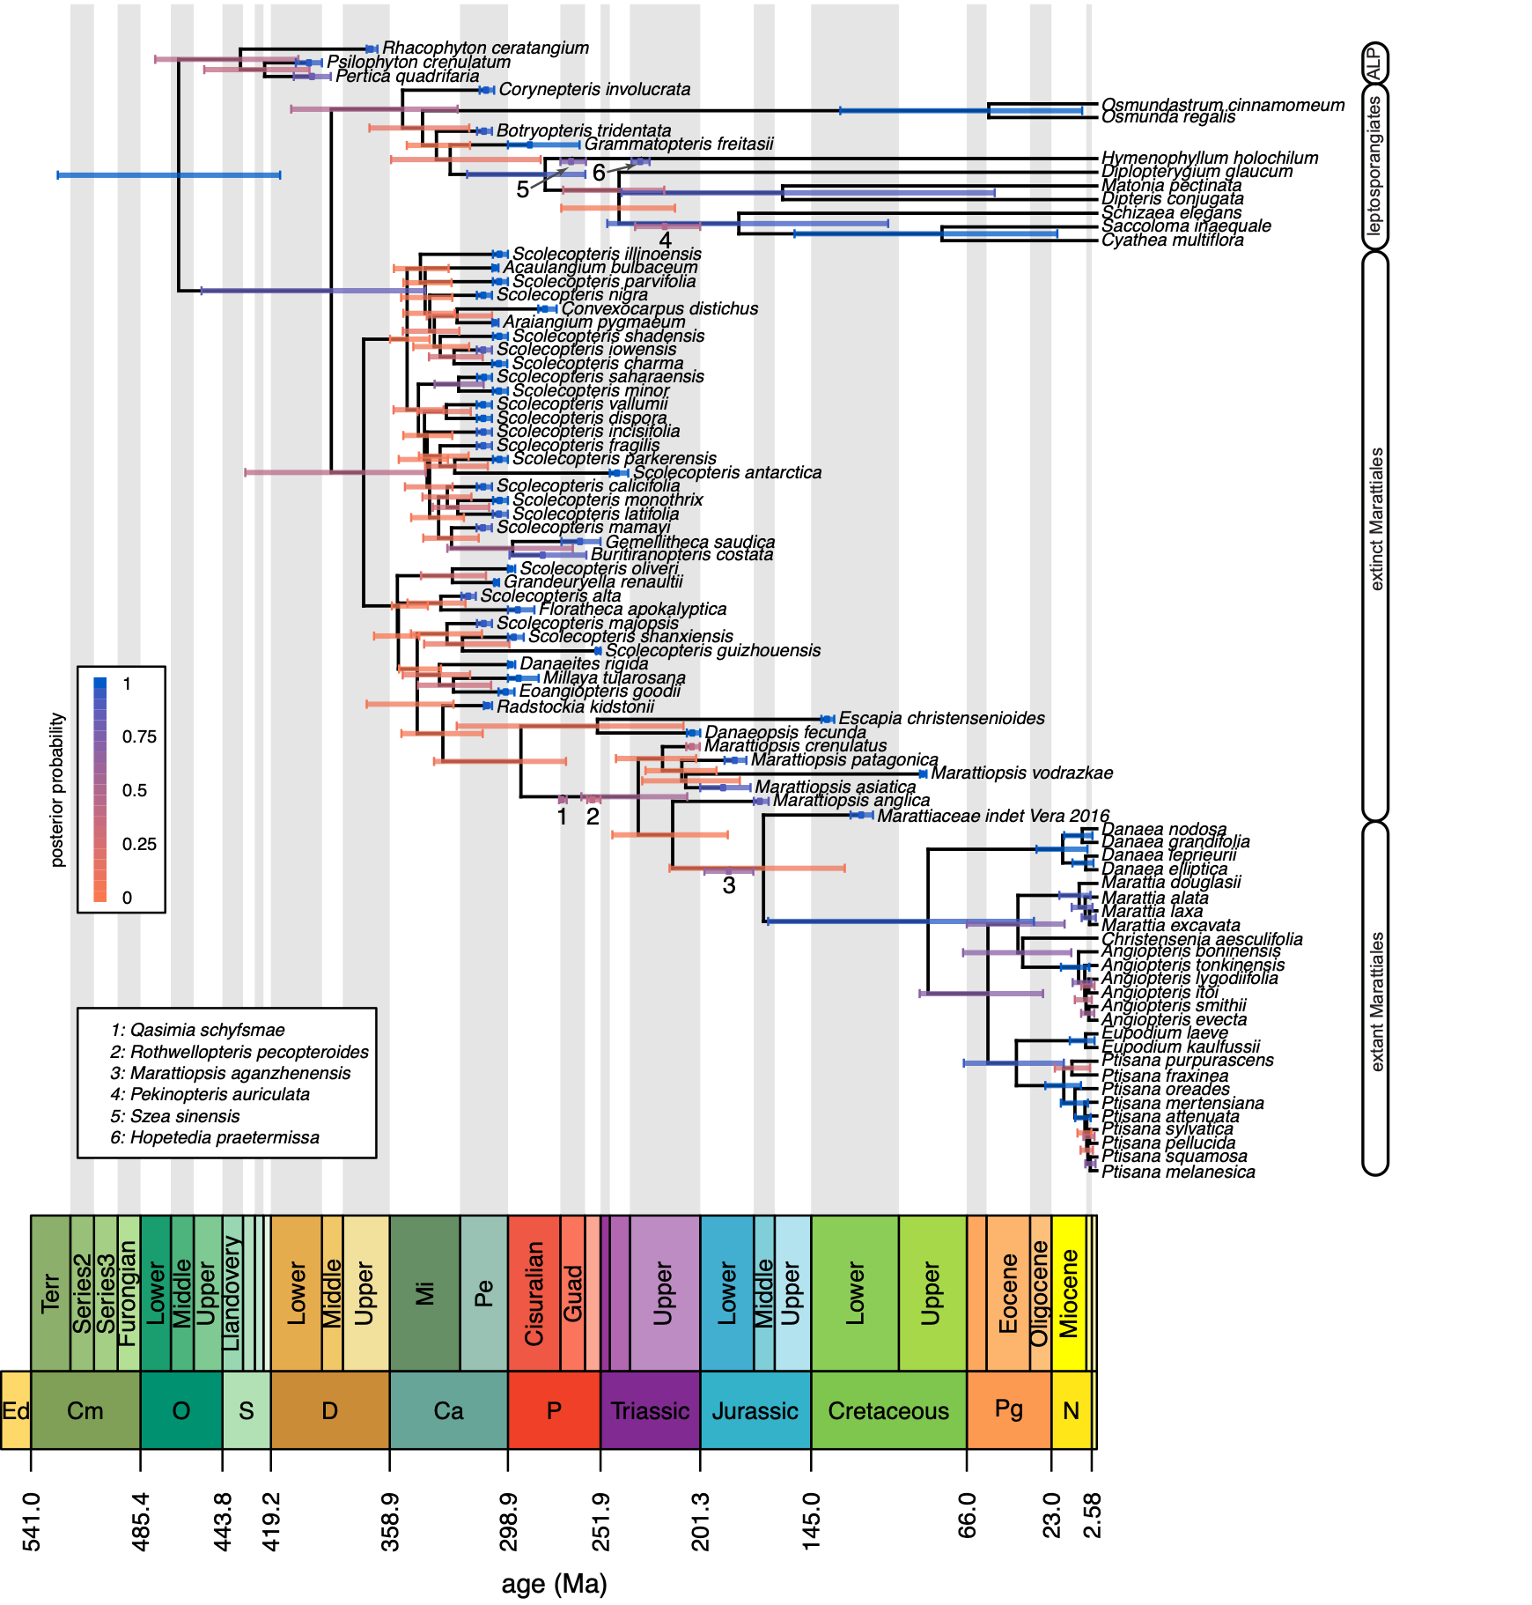
Why phylogenetics?
And so much more… you can:
Infer how lineages moved through space (biogeography)
Infer how characters changed over time (morphological and molecular evolution)
Infer how lineages have diversified (infer speciation and extinction rates, and see if they are correlated with particular features of the organism)
Quantify the distribution of evolutionary diversity over space (phylodiversity)
Infer the timing of major evolutionary events
Infer the history of novel pathogens (e.g., the origin and spread of SARS-CoV-2)
Detect signatures of natural selection on individual genes (identify particular amino acids that are under selection in SARS-CoV-2)
Infer the history of populations: their ancestral population sizes, patterns of migration, etc.
May et al. 2021 Syst Biol

Slide 22
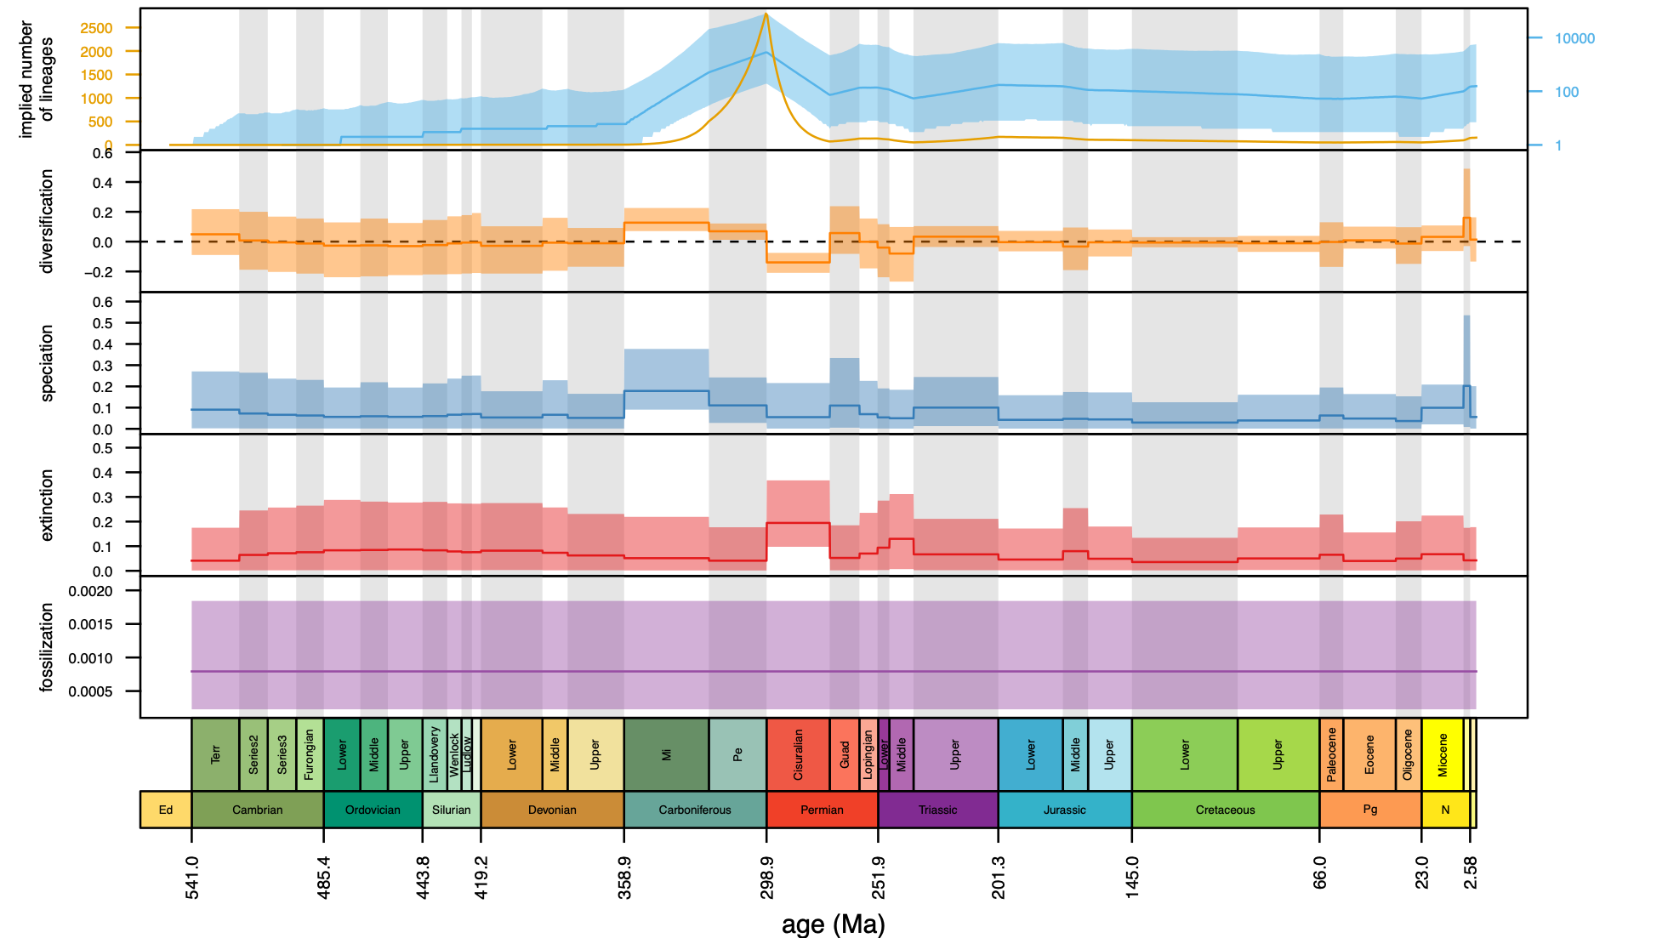
Why phylogenetics?
And so much more… you can:
Infer how lineages moved through space (biogeography)
Infer how characters changed over time (morphological and molecular evolution)
Infer how lineages have diversified (infer speciation and extinction rates, and see if they are correlated with particular features of the organism)
Quantify the distribution of evolutionary diversity over space (phylodiversity)
Infer the timing of major evolutionary events
Infer the history of novel pathogens (e.g., the origin and spread of SARS-CoV-2)
Detect signatures of natural selection on individual genes (identify particular amino acids that are under selection in SARS-CoV-2)
Infer the history of populations: their ancestral population sizes, patterns of migration, etc.
May et al. 2021 Syst Biol

Slide 23
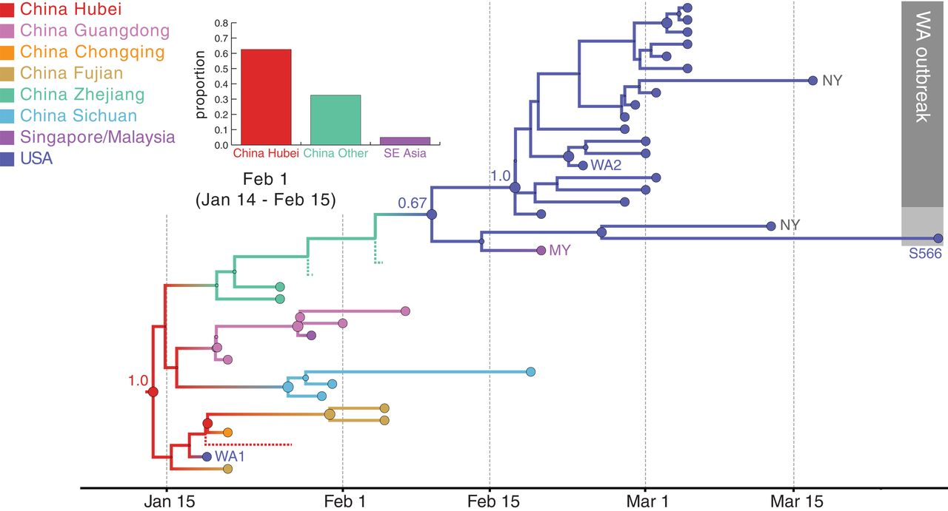
Why phylogenetics?
And so much more… you can:
Infer how lineages moved through space (biogeography)
Infer how characters changed over time (morphological and molecular evolution)
Infer how lineages have diversified (infer speciation and extinction rates, and see if they are correlated with particular features of the organism)
Quantify the distribution of evolutionary diversity over space (phylodiversity)
Infer the timing of major evolutionary events
Infer the history of novel pathogens (e.g., the origin and spread of SARS-CoV-2)
Detect signatures of natural selection on individual genes (identify particular amino acids that are under selection in SARS-CoV-2)
Infer the history of populations: their ancestral population sizes, patterns of migration, etc.
Worobey et al. 2020 Science

Slide 24
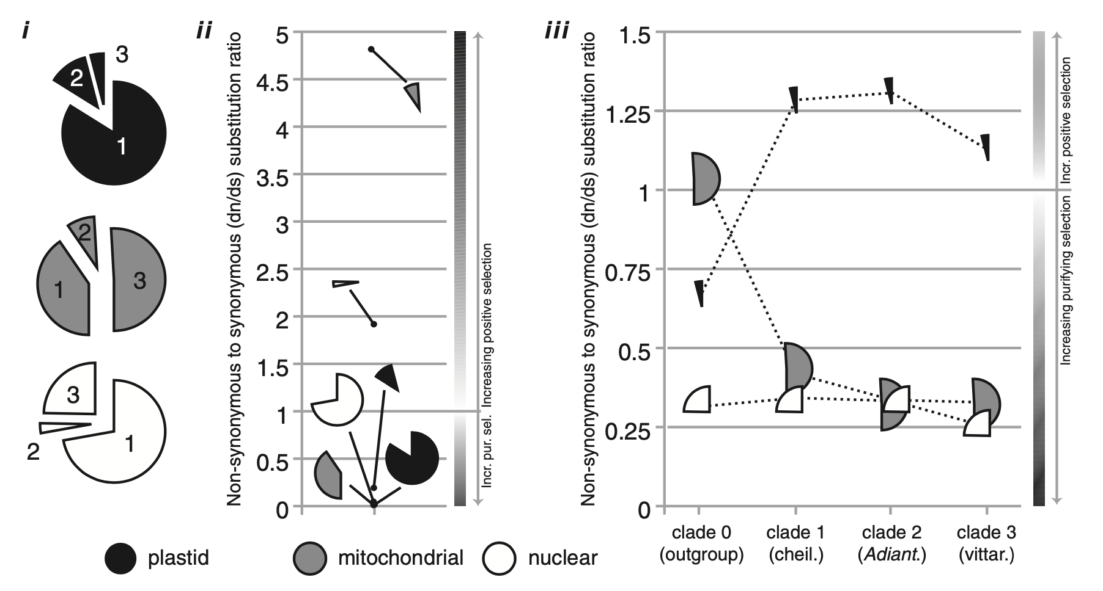
Why phylogenetics?
And so much more… you can:
Infer how lineages moved through space (biogeography)
Infer how characters changed over time (morphological and molecular evolution)
Infer how lineages have diversified (infer speciation and extinction rates, and see if they are correlated with particular features of the organism)
Quantify the distribution of evolutionary diversity over space (phylodiversity)
Infer the timing of major evolutionary events
Infer the history of novel pathogens (e.g., the origin and spread of SARS-CoV-2)
Detect signatures of natural selection on individual genes (identify particular amino acids that are under selection in SARS-CoV-2)
Infer the history of populations: their ancestral population sizes, patterns of migration, etc.
Rothfels and Schuettpelz 2014 Syst Biol

Slide 25
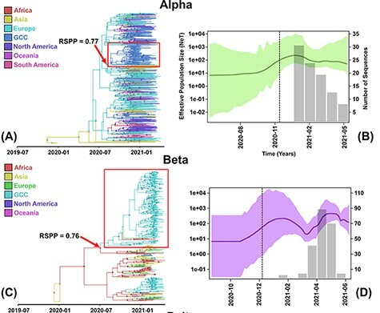
Why phylogenetics?
And so much more… you can:
Infer how lineages moved through space (biogeography)
Infer how characters changed over time (morphological and molecular evolution)
Infer how lineages have diversified (infer speciation and extinction rates, and see if they are correlated with particular features of the organism)
Quantify the distribution of evolutionary diversity over space (phylodiversity)
Infer the timing of major evolutionary events
Infer the history of novel pathogens (e.g., the origin and spread of SARS-CoV-2)
Detect signatures of natural selection on individual genes (identify particular amino acids that are under selection in SARS-CoV-2)
Infer the history of populations: their ancestral population sizes, patterns of migration, etc.
Alkhamis et al. 2022 Virus Evol

Slide 26
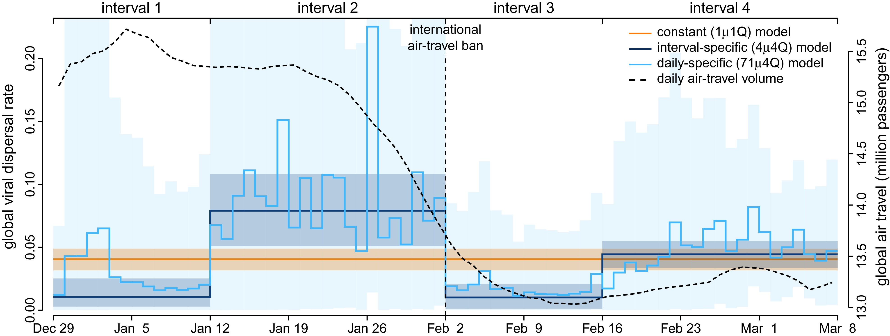
Why phylogenetics?
And so much more… you can:
Infer how lineages moved through space (biogeography)
Infer how characters changed over time (morphological and molecular evolution)
Infer how lineages have diversified (infer speciation and extinction rates, and see if they are correlated with particular features of the organism)
Quantify the distribution of evolutionary diversity over space (phylodiversity)
Infer the timing of major evolutionary events
Infer the history of novel pathogens (e.g., the origin and spread of SARS-CoV-2)
Detect signatures of natural selection on individual genes (identify particular amino acids that are under selection in SARS-CoV-2)
Infer the history of populations: their ancestral population sizes, patterns of migration, etc.
Gao et al. 2022 MBE

Slide 27
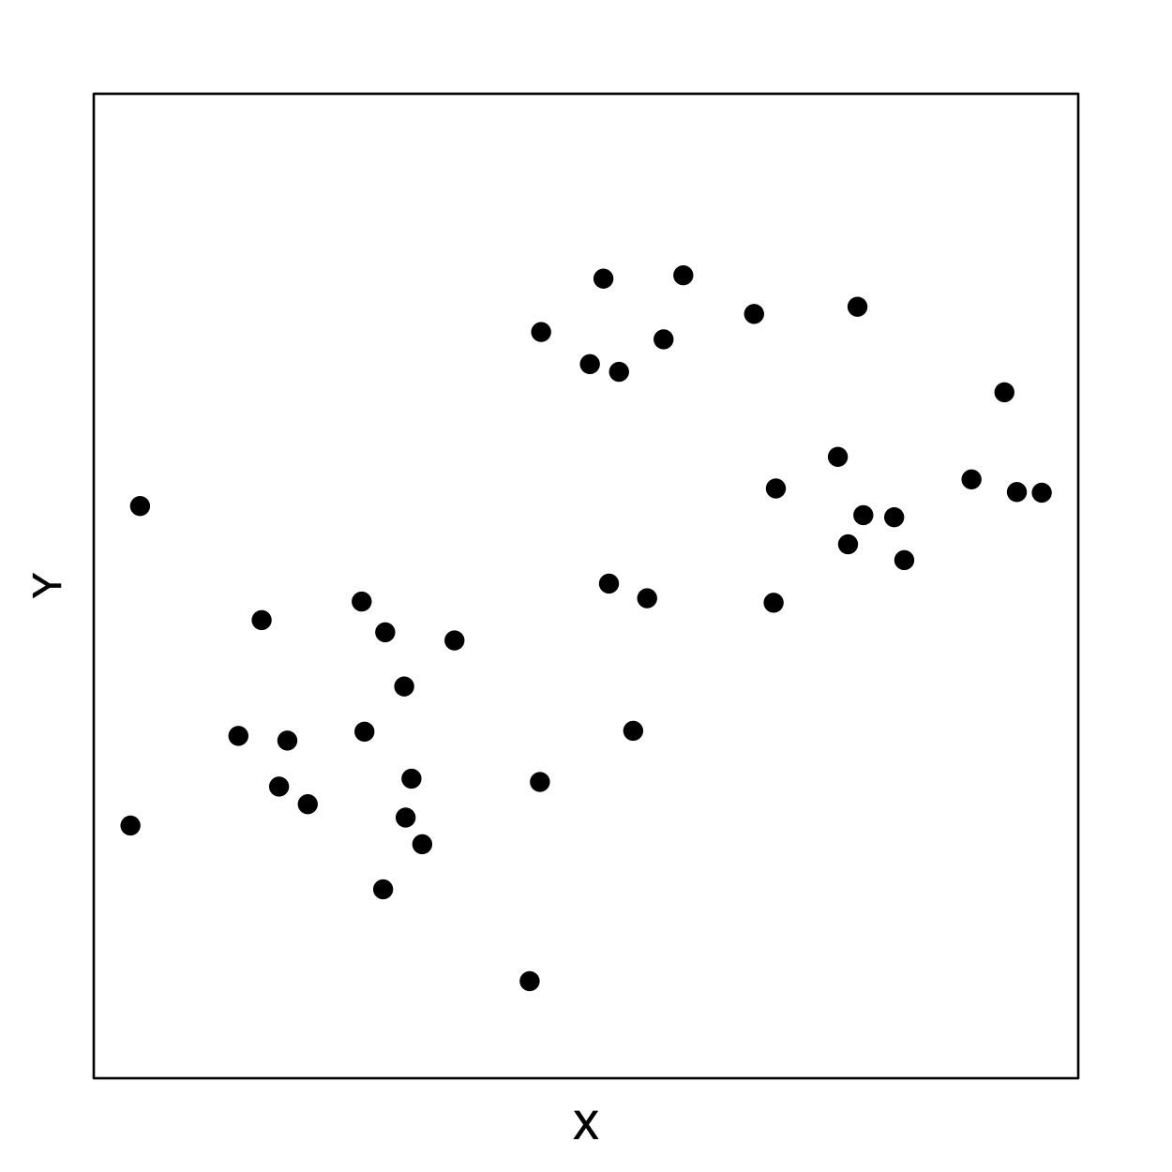
Why phylogenetics?
Finally, even if you don’t care about the phylogeny itself
Evolution is a branching process, so it is often necessary to understand phylogeny in order to correctly interpret biological data: The “Comparative Method”
But there are many other reasons why it is useful to know what is related to what. E.g., so that we can bust a doctor who injected his former girlfriend with HIV from one of his patients

Slide 28
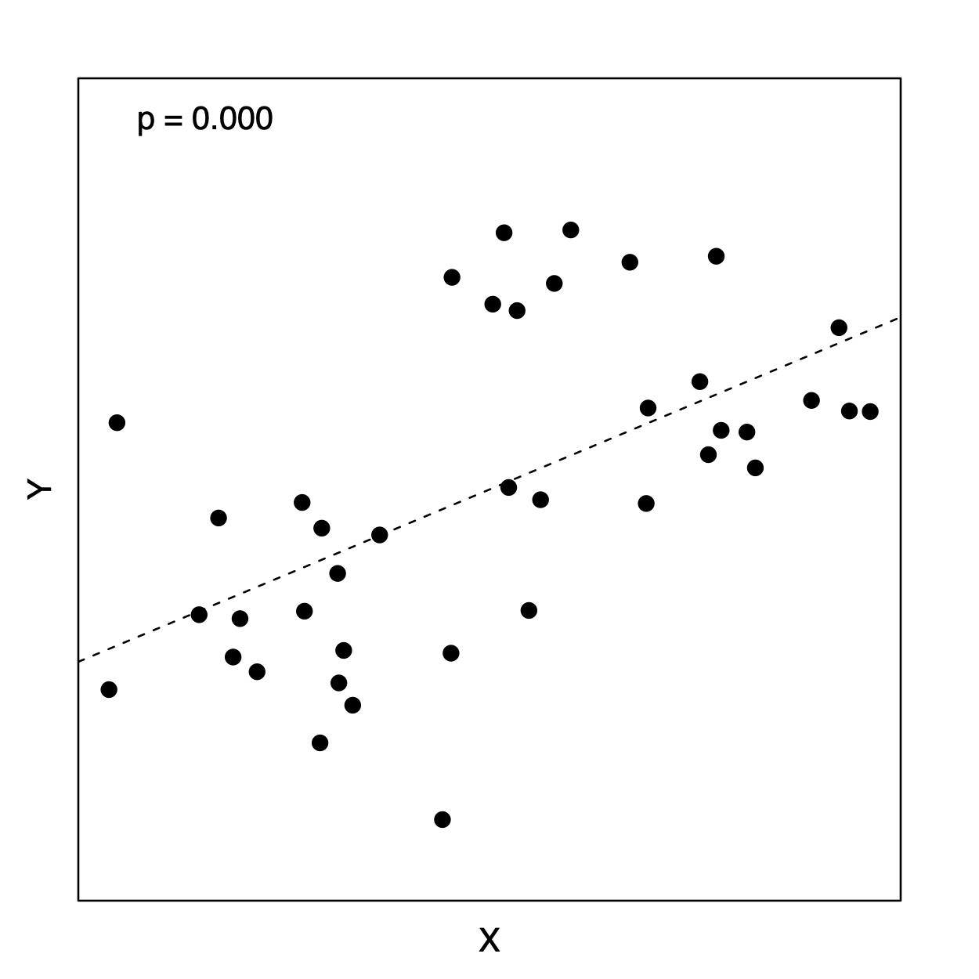
Why phylogenetics?
Finally, even if you don’t care about the phylogeny itself
Evolution is a branching process, so it is often necessary to understand phylogeny in order to correctly interpret biological data: The “Comparative Method”
But there are many other reasons why it is useful to know what is related to what. E.g., so that we can bust a doctor who injected his former girlfriend with HIV from one of his patients

Slide 29
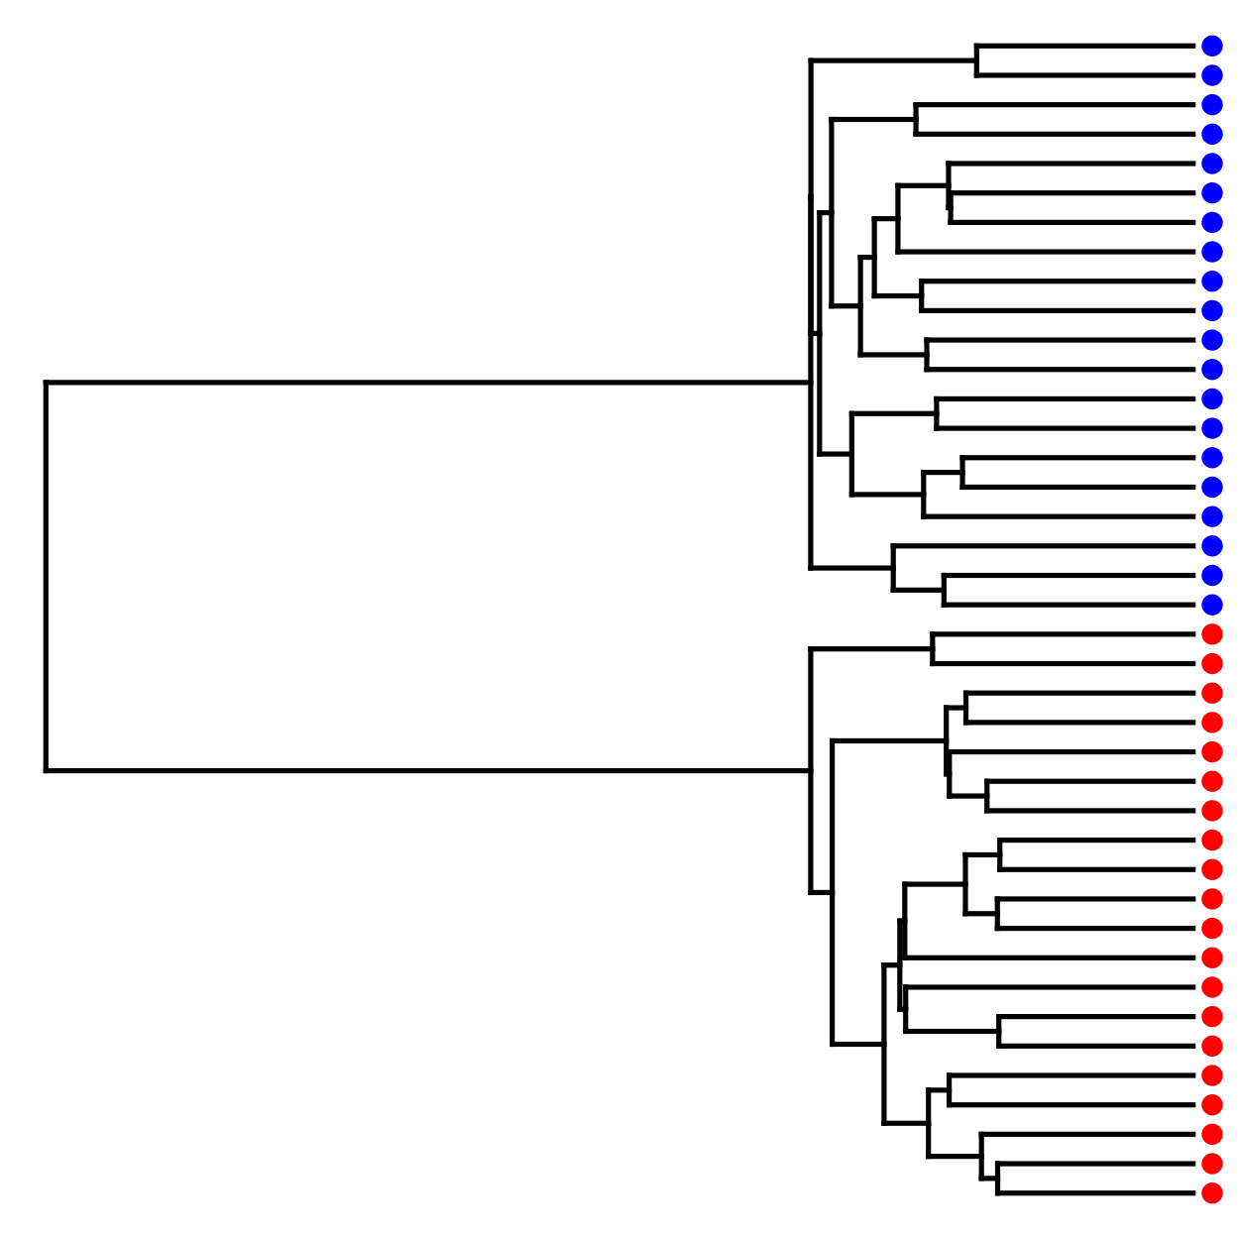
Why phylogenetics?
Finally, even if you don’t care about the phylogeny itself
Evolution is a branching process, so it is often necessary to understand phylogeny in order to correctly interpret biological data: The “Comparative Method”
But there are many other reasons why it is useful to know what is related to what. E.g., so that we can bust a doctor who injected his former girlfriend with HIV from one of his patients

Slide 30
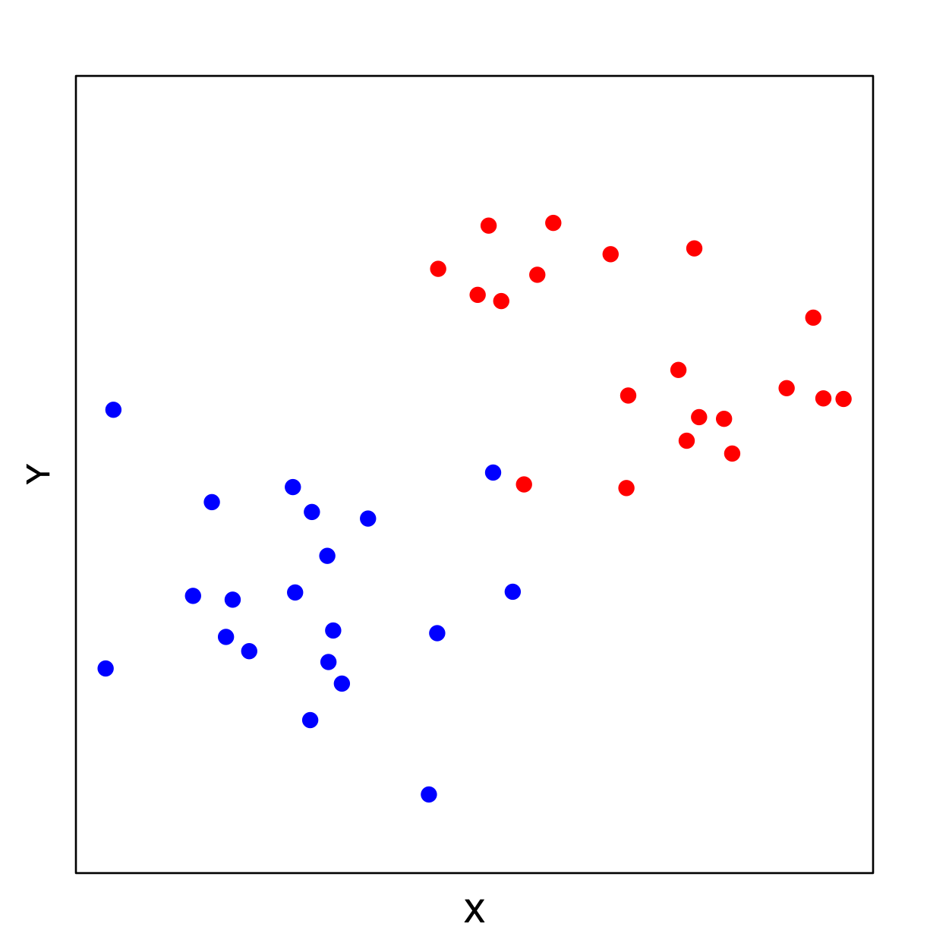
Why phylogenetics?
Finally, even if you don’t care about the phylogeny itself
Evolution is a branching process, so it is often necessary to understand phylogeny in order to correctly interpret biological data: The “Comparative Method”
But there are many other reasons why it is useful to know what is related to what. E.g., so that we can bust a doctor who injected his former girlfriend with HIV from one of his patients

Slide 31
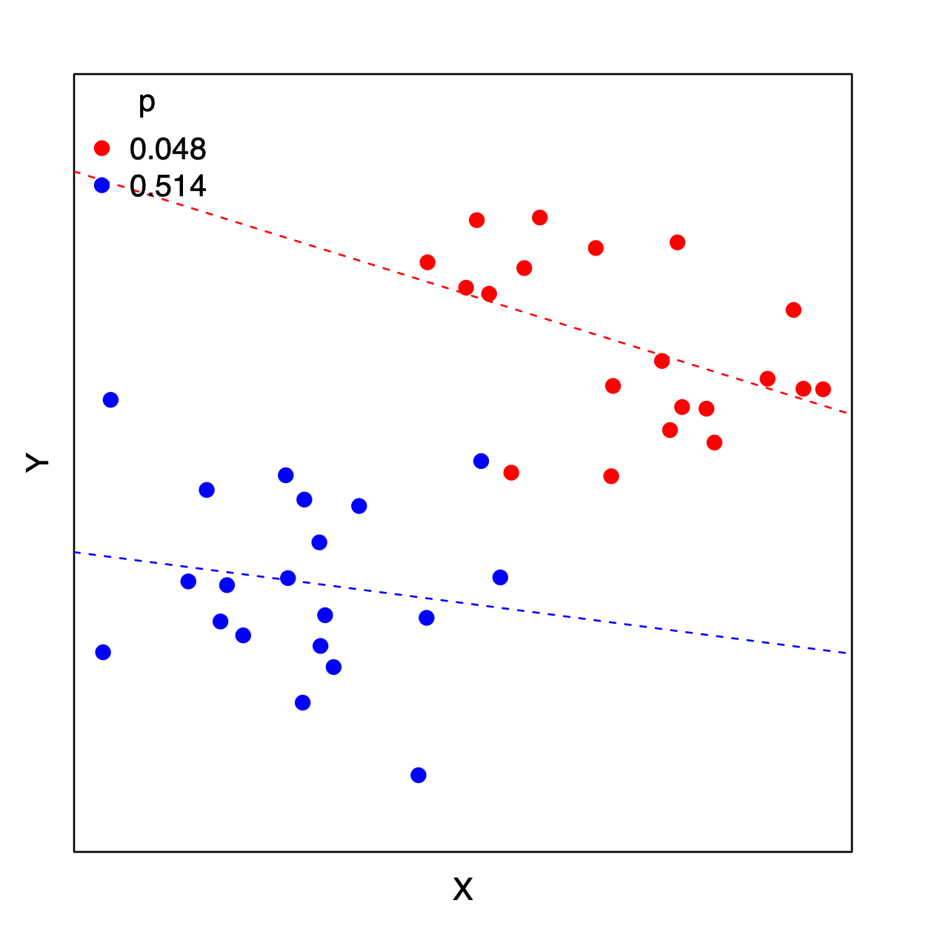
Why phylogenetics?
Finally, even if you don’t care about the phylogeny itself
Evolution is a branching process, so it is often necessary to understand phylogeny in order to correctly interpret biological data: The “Comparative Method”
But there are many other reasons why it is useful to know what is related to what. E.g., so that we can bust a doctor who injected his former girlfriend with HIV from one of his patients

